Slide 1



Food Websites
Group Members
1- Shivam Khetwal(2061929)
2- Divyansh Joshi(2061805)

Slide 2

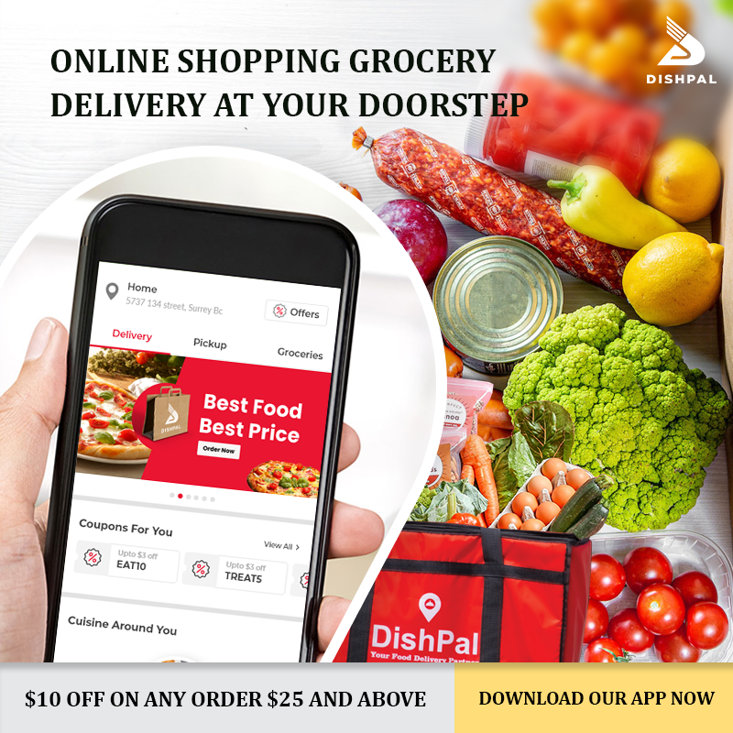
Contents
Introduction.
History of food delivery.
Types of Food Websites
Cost to build a Food website
Advantages and disadvantages.
References to our website code.
Html code, CSS and JavaScript.
Conclusion.

Slide 3



Introduction
The key to a good food website— whether it’s a recipe blog, a restaurant website or selling a product— is photography. When you browse the designs below, notice how all the best designs have excellent photography.
A good food website design don’t need to be ornamental— it can be simple and straightforward in order to let the food photography shine. It’s not that branding isn’t important, it’s just that it’s best communicated through colors and logos.
FreshDirect is an online grocery delivery service in the United States. Initially established in New York City, the company expanded to include much of the New York Metropolitan area as well as select counties in New Jersey.
FreshDirect custom-packages groceries and meals for its customers using just-in-time manufacturing, a practice that reduces waste, and improves quality and freshness.
The company offers its services via a website and mobile app.
This Photo by Unknown Author is licensed under CC BY-SA
This Photo by Unknown Author is licensed under CC BY-SA

Slide 4
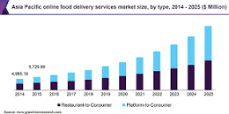
History of Food Delivery
1889: The first pizza is delivered
1890s: Dabbawallas deliver lunch to workers in India
1922: Chinese food delivery arrives in America
1950s: Restaurant food delivery takes off
1954: Meals on Wheels launches
1960s: Delivery speed improves
1994: Pizza Hut launches Pizzanet
1995: World Wide Waiter goes online

Slide 5
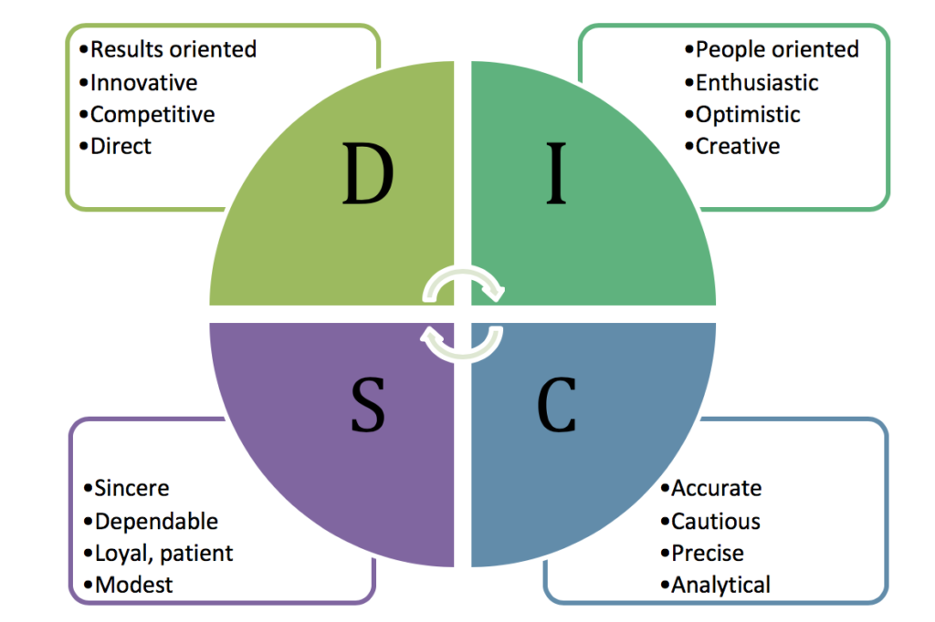
Types of Food Websites
Restaurant Prepared Food Delivery This is a kind of on-demand delivery service that has disrupted the traditional market. Social media mentions of such delivery services have skyrocketed in recent times, more so due to COVID19 outbreak.
Meal Kits Delivery Companies like Blue Apron, Freshly are catering to this segment. Expected to reach USD 20 billion by 2027 as per Grand View Research, this is mainly opted by busy and overworked families
Grocery Delivery Grocery delivery business has seen a sudden spike during the pandemic and will continue with its growth in the next couple of years. Mostly the business starts with either a web portal or app and delivers groceries to the customers from a warehouse or offline store where the items are stocked.
Veggie Box Delivery Vegetable box subscriptions are on the rise nowadays. These can range from Community-Shared Agriculture boxes (CSA boxes) to corporate equivalent which are branded boxes of vegetables and fruits.
This Photo by Unknown Author is licensed under CC BY-NC

Slide 6
How much does it cost to build a food delivery website?
The price of food delivery website development consists of many factors. They are the number of features, development company rate and the difficulty of the projects. Mostly, it depends on whether you want to use a template solution or to build a full custom CMS system for your website. In this case, we highly recommend starting a project with an MVP
The average hourly rate varies depending on the developer's location. For instance, the hourly rate of developers from the USA is from $60 to $100. At the same time, the developers from Eastern Europe, in particular, Ukraine, charge only $30-$40 per hour. On average, creating a food delivery website will cost about $7000, depending on the selected functionality.

Slide 7
MVP of a custom food delivery website
Catalogue management | 160 hours
Content views | 85 hours
Authorization and security | 70 hours
Reviews and rating | 68 hours
Ordering functionality | 68 hours
Payments | 43 hours
Delivery tracking | 43 hours
User profiles | 43 hours
UI/UX | 34 hours
Database and deployment script | 30 hours
Notifications | 30 hours

Slide 8
Key Food Delivery Challenges Let’s look at those critical challenges faced by the current players in food delivery space.
1. The Shift in Customer Preferences Increasing the market share by offering the best possible value to customers at the best possible cost should be the main focus of the food delivery business.
2. Fluctuating Market Prices Prices for raw materials to prepare food is also highly volatile. In this kind of scenario, getting the right price and grabbing customer attention is a huge challenge.

Slide 9
Adhering to Quality Standards The massive surge in online orders makes businesses strive for maintaining food quality standards.
Improper Handling of Food Mishandling of ordered food items is the biggest challenge faced by the industry currently
Logistical Challenges A major chunk of the business depends on how efficiently the logistics work to cater to a wider geography.

Slide 10
Final thoughts(Conclusion)
The food delivery market is viral among consumers. Moreover, it is a prospective field for investments.
If you want to create your food delivery website, you have two options.
You can use a template for your future site and hire a development team to customize it for your needs. Alternatively, you can hire a team to develop a fully custom solution for food ordering and delivery, which might be costly yet beneficial.

Slide 11
Why is a food delivery service important?
Wider Variety Food delivery service gives a plethora of options to choose from at the comfort of your home. You can choose your favourite cuisine from a wide range of restaurants.
Cost efficiency for Customers It is cost-effective to order food, the reason is that you cut on your travelling expense and time.
Easily Accessible Just a smartphone with Android or iOS is needed that supports the app. Rest all is just a click away.

Slide 12
Varied Modes of Payment Making a payment is quite convenient while placing an order for food delivery services.

Slide 13

Disadvantages
Deliverymen Put Themselves in Danger
Whether it is a heatwave boiling down the city or it is snowing or raining heavily, a Delivery Boy is waiting outside the restaurant to pick and deliver your order.
Disguised Increased Expense
Revenue Conflicts Between The Restaurants and Delivery Providers
Juggling With Your Health
the deliveries, the restaurants heat it up so quickly that it kills almost all the nutrients of the food you eat.
Moreover, many cases have been noted where people who consume this type of food, face health issues such as food poisoning and consumption on a regular basis, which makes them obese as well. Compromise With the Food Quality
In comparison to eating out in a restaurant, the food from the delivery service is packed in plastic bags and may get cold if the distance of your restaurant is far from your delivery address.

Slide 14
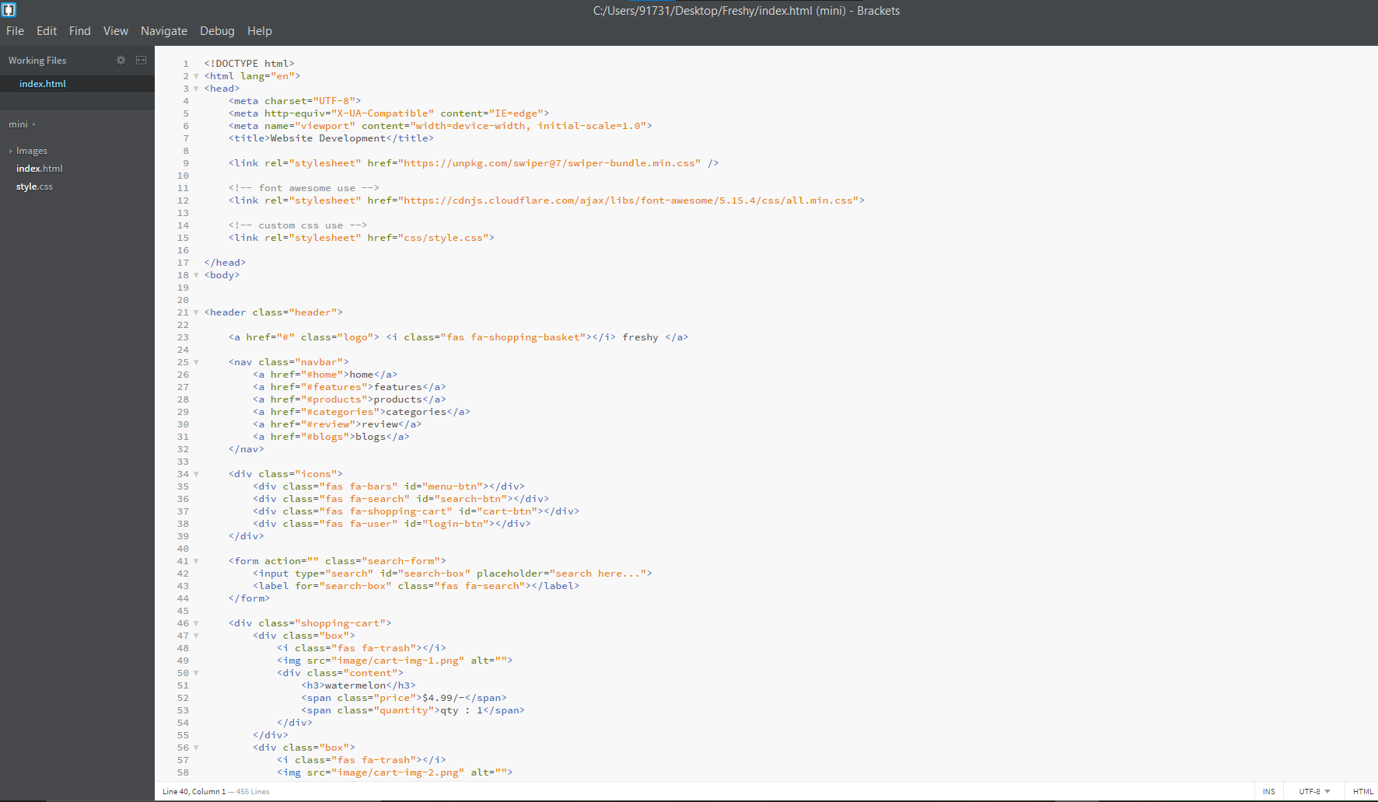
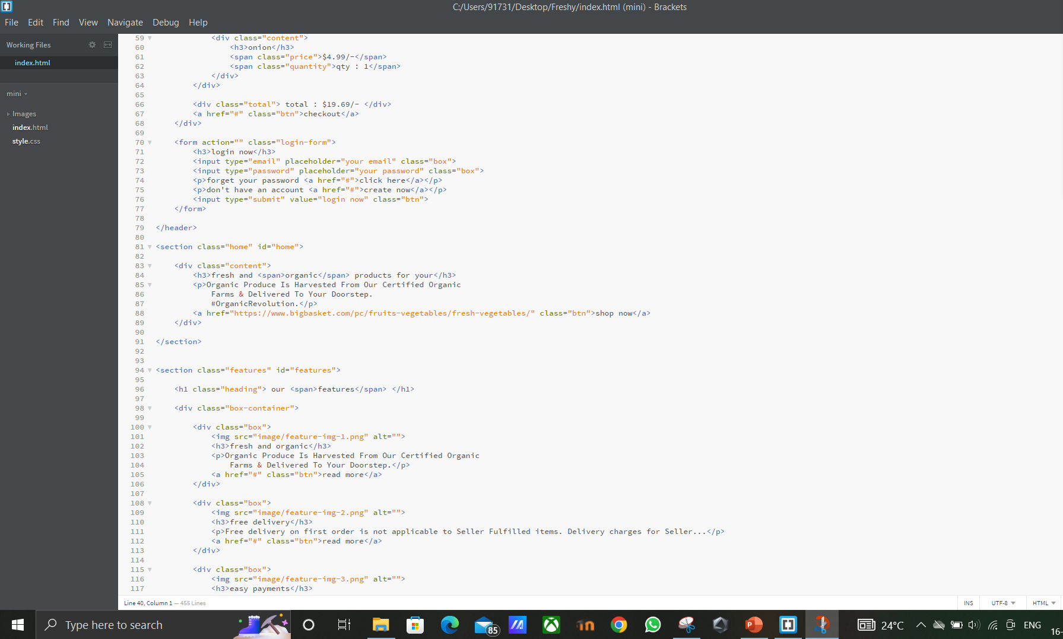
Reference to our code(Html code)

Slide 15
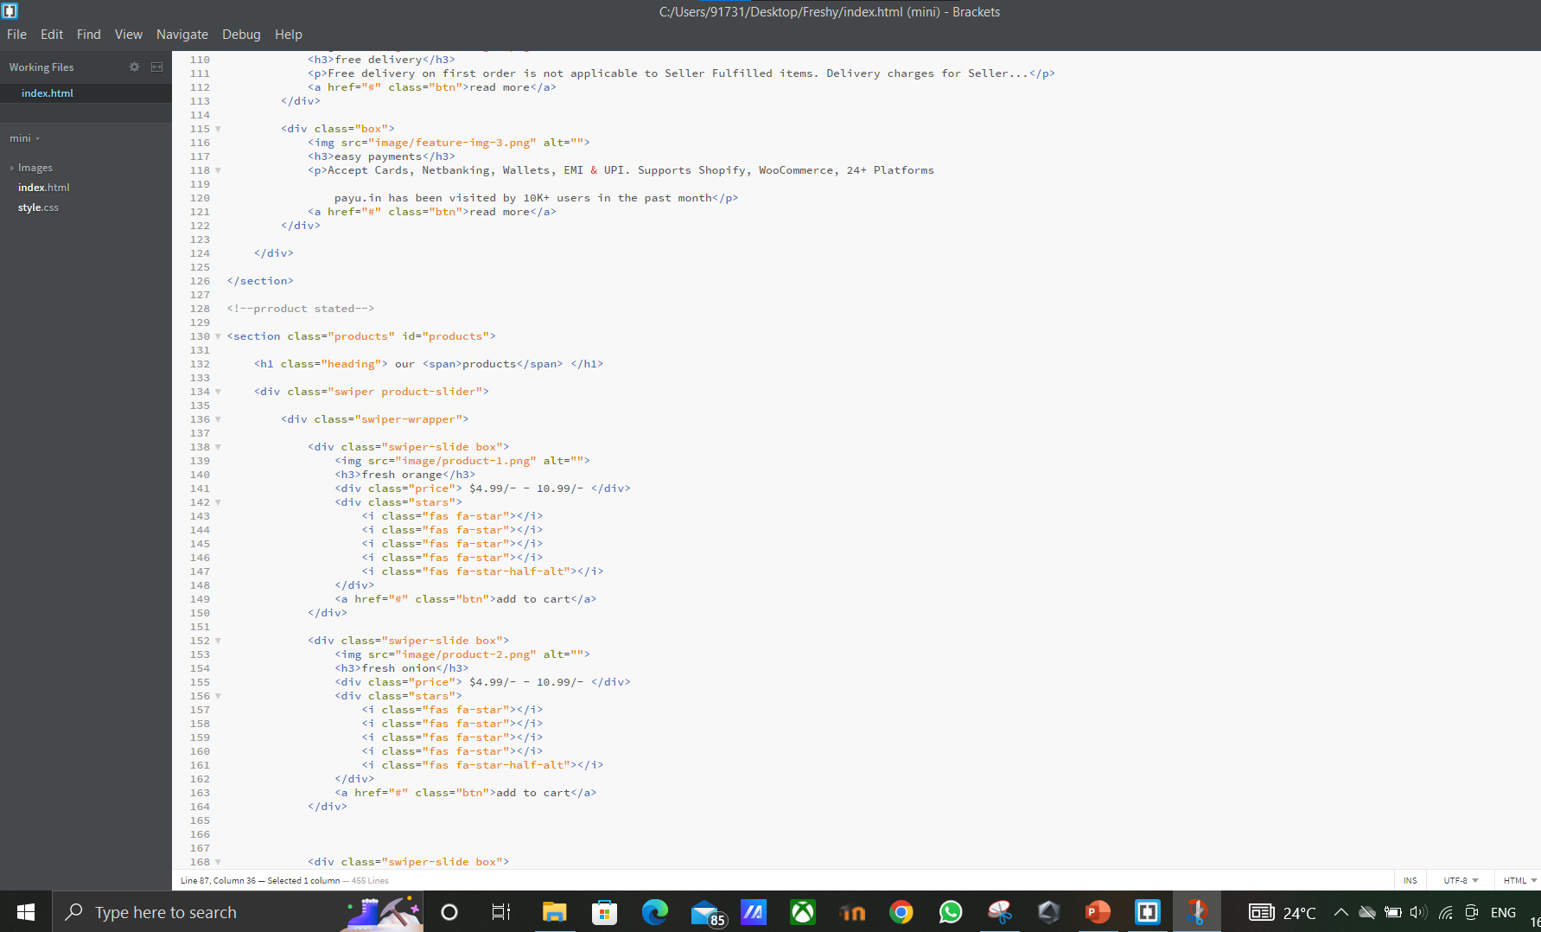
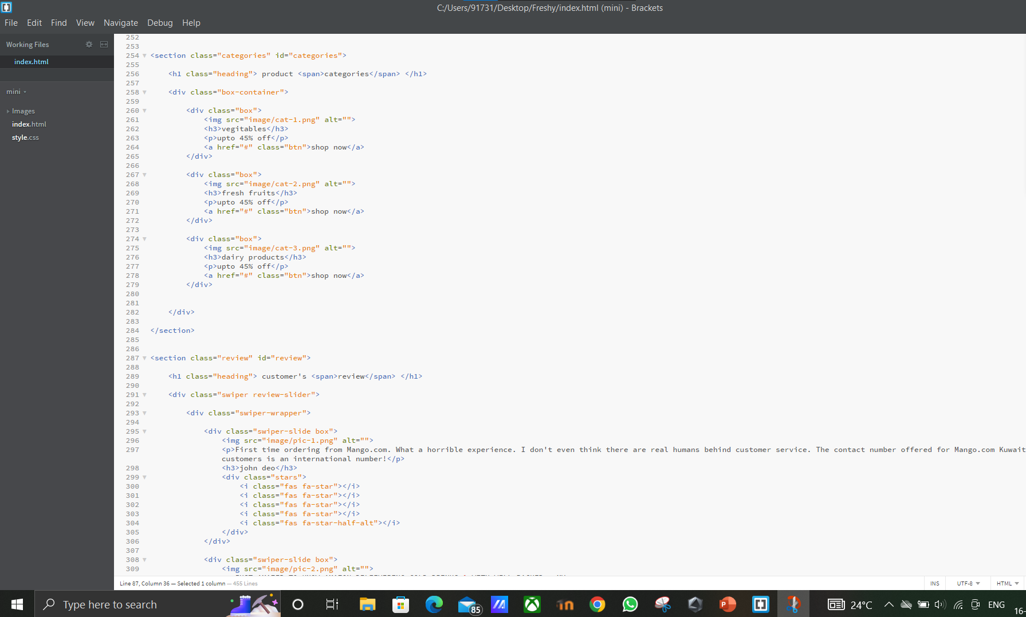

Slide 16
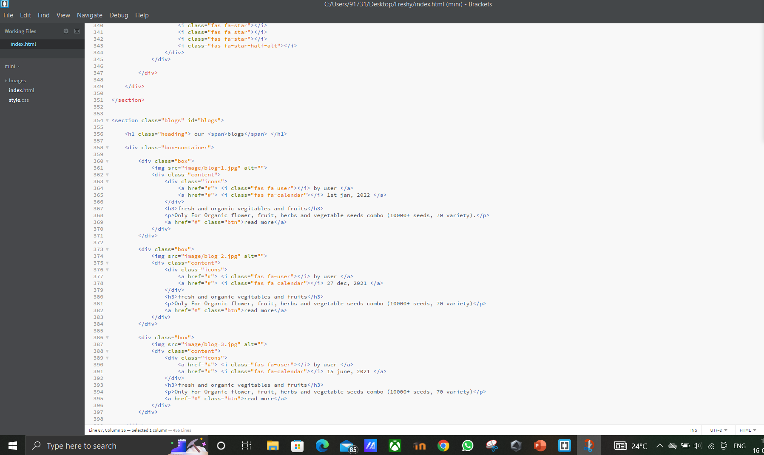
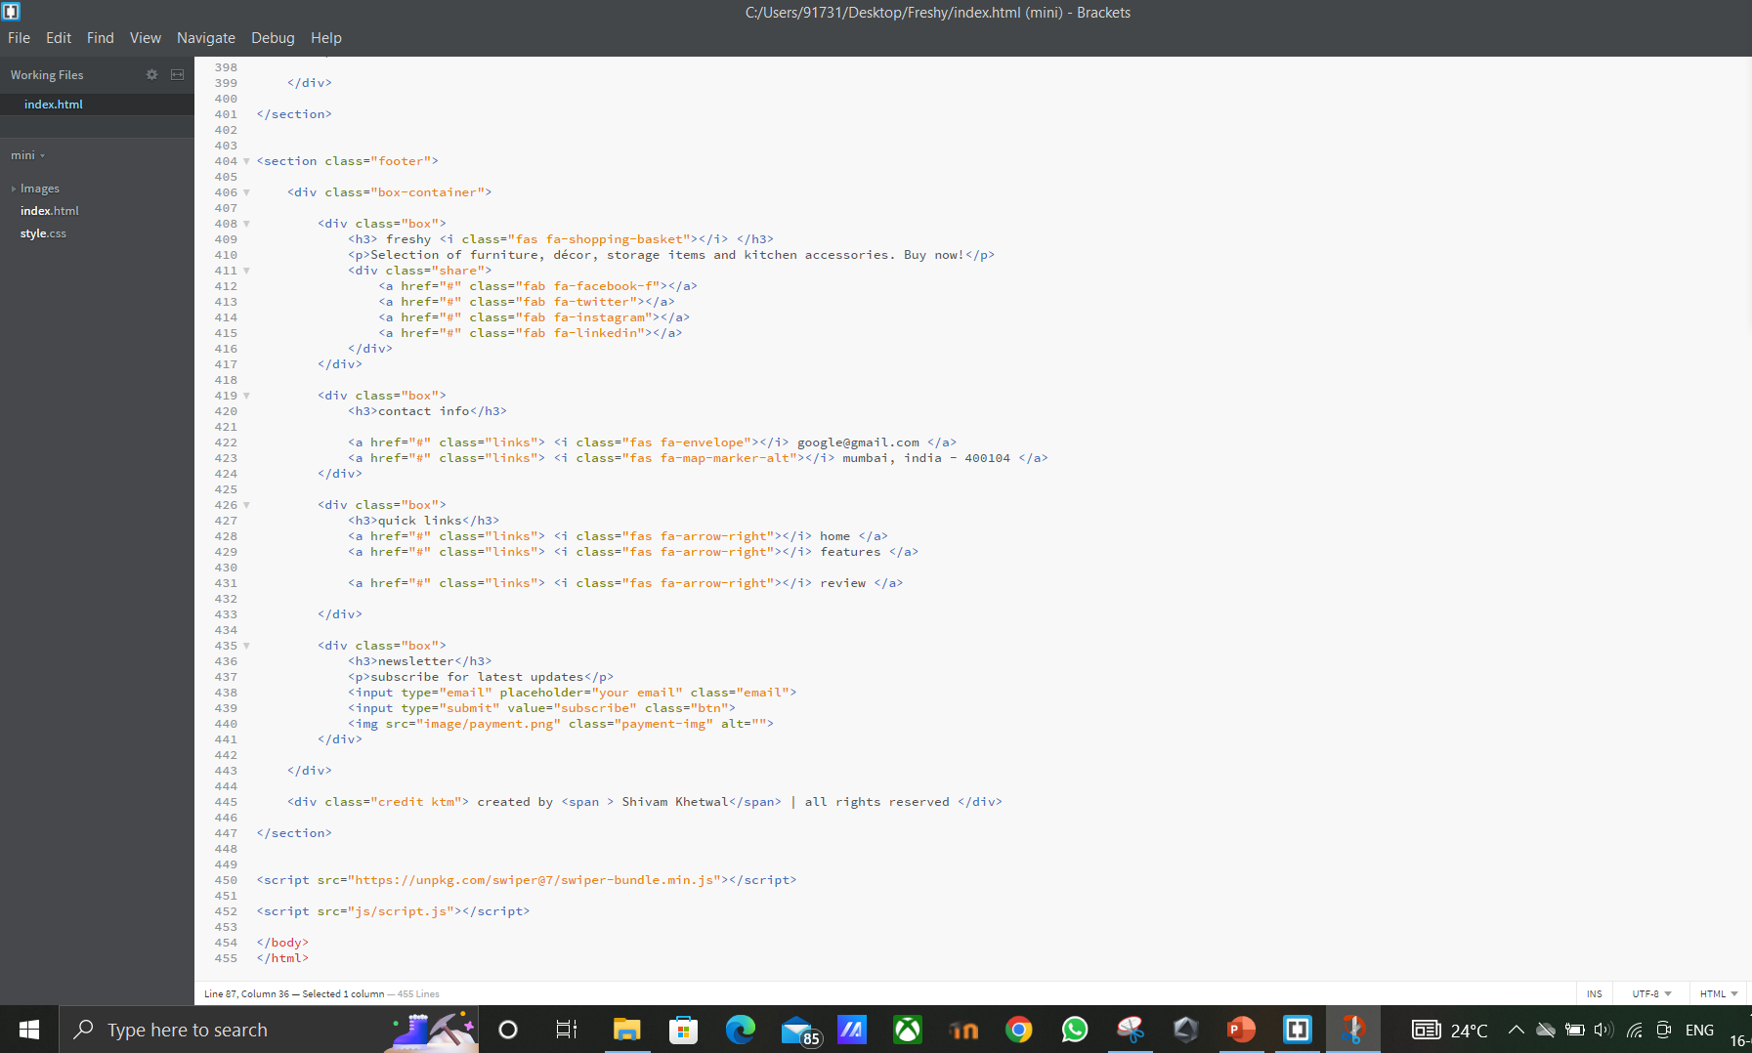

Slide 17
CSS code

Slide 18


Slide 19


Slide 20


JavaScript

Slide 21


Slide 22


Slide 23
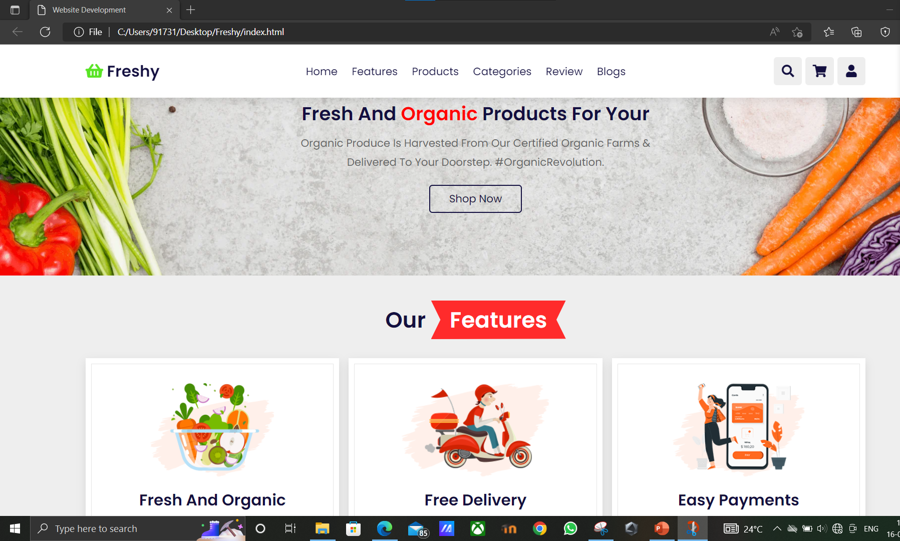
Website Output

Slide 24
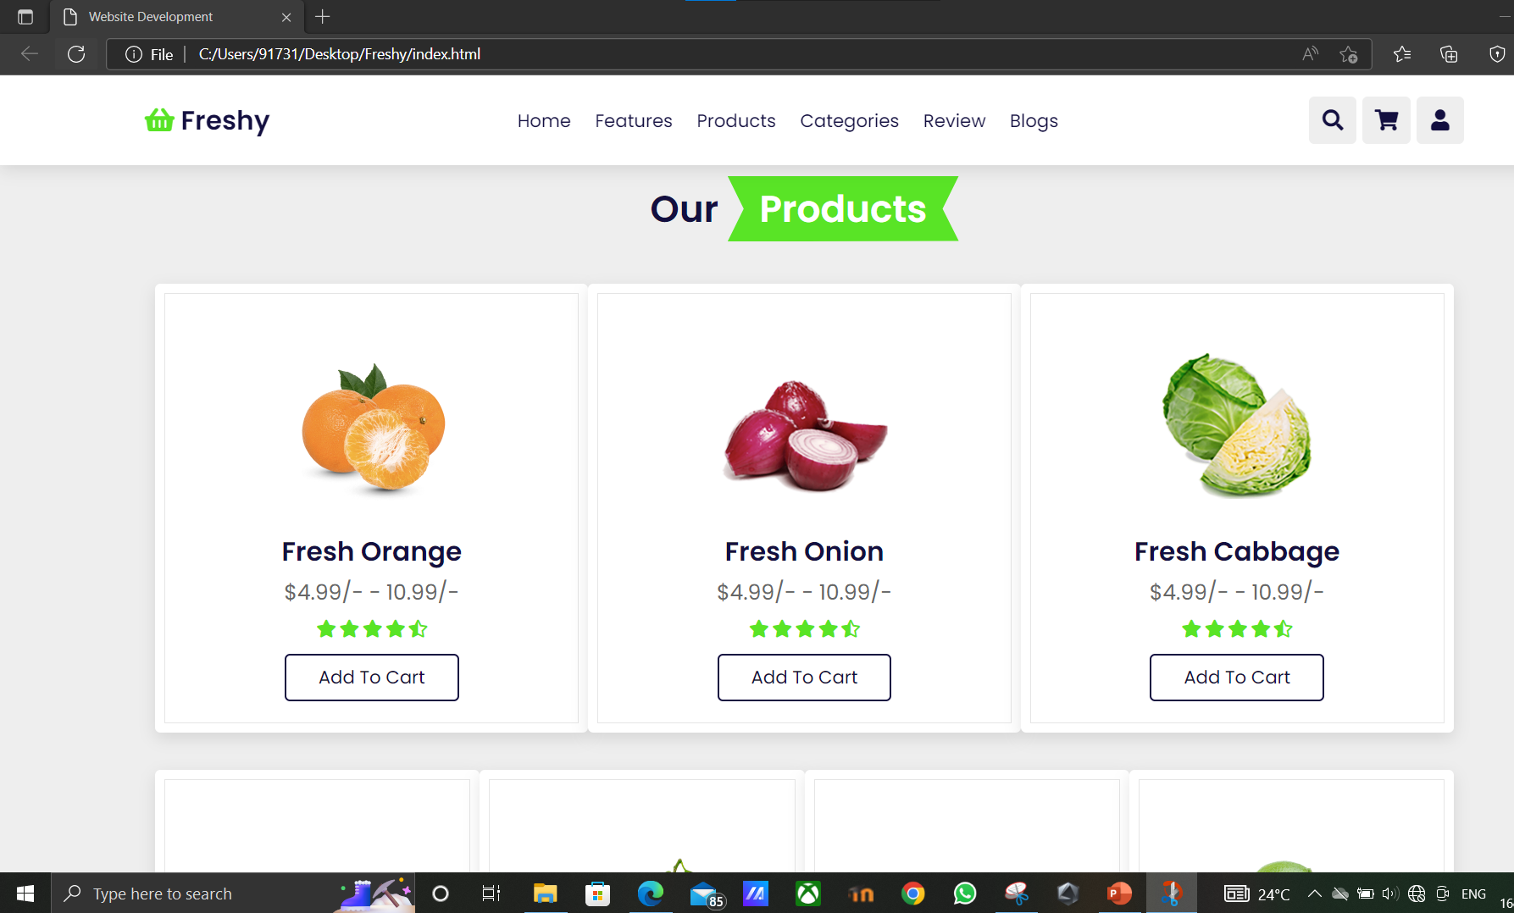

Slide 25
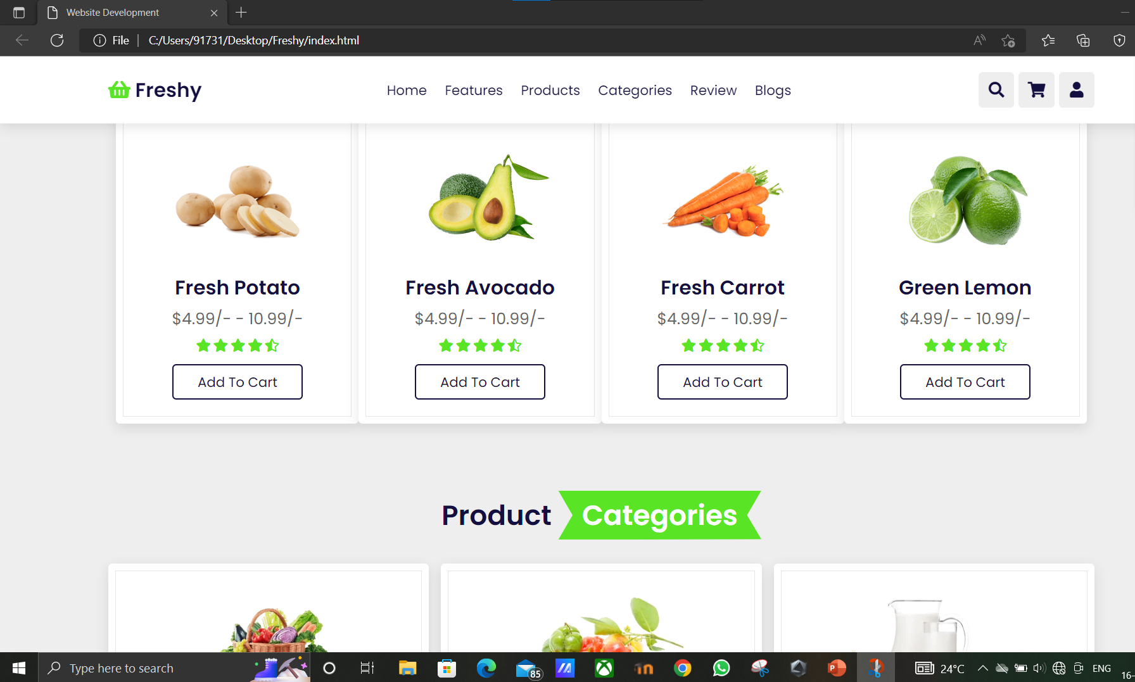

Slide 26
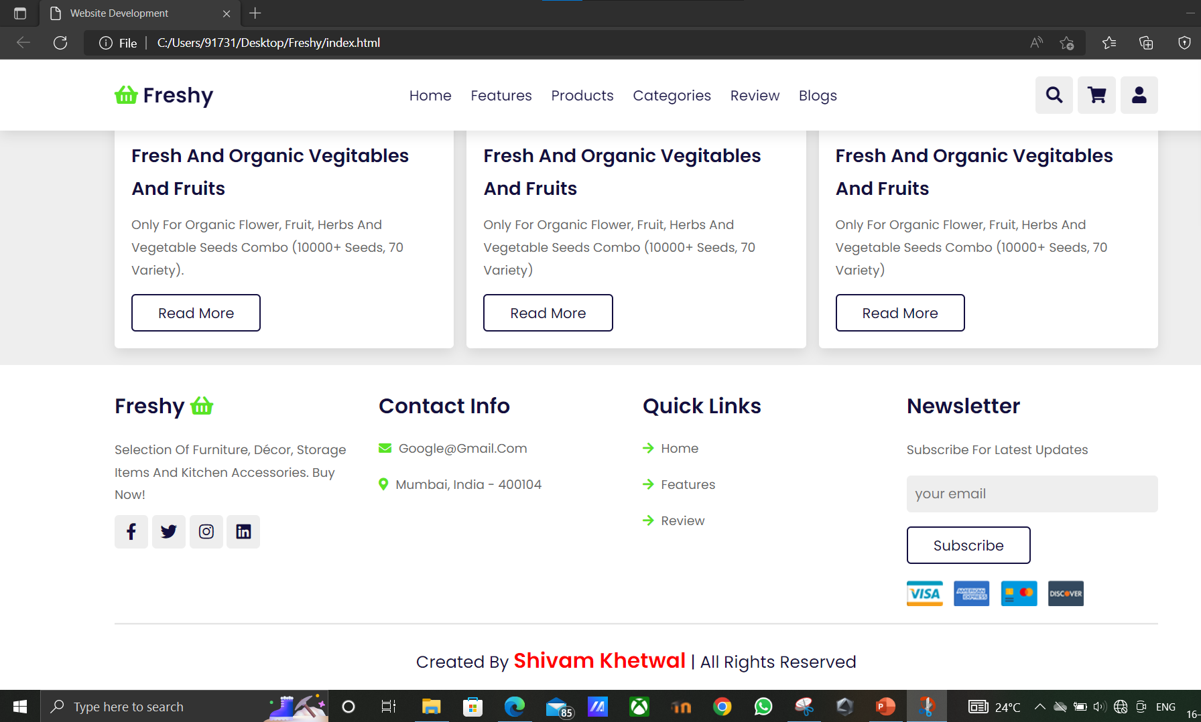

Slide 27

This Photo by Unknown Author is licensed under CC BY-ND

